Slide 1
Contract NLI
Guided by: Dr. Manish Shrivastava
TA: Patanjali
Team 19 (Badhum)
Viraj Shah (2023201011)
Sushrut Naik (2023201064)
Ronak Patel (2023201074)

Slide 2
Problem Statement
Natural Language Inference(NLI) and evidence identification in large documents, specifically NDAs
NLI – Given hypothesis and premise, identify relationship
Entailment
Contradiction
Not Mentioned
Evidence Identification – If entailment or contradiction, which part of the premise supports that relationship

Slide 3
Dataset
Statistics
Avg Paragraphs: 43.7
Avg Tokens: 2254.3
Avg Spans: 77.8
Format | Source | Train | Dev | Test | Total
Plain Text | EDGAR | 83 | 12 | 24 | 119
HTML | EDGAR | 79 | 11 | 23 | 113
PDF | Search Engines | 261 | 38 | 76 | 375
Total |  | 423 | 61 | 123 | 607

Slide 4
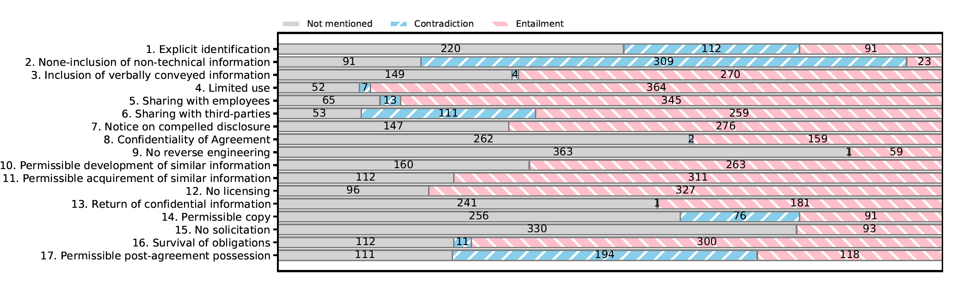
Label Distribution

Slide 5
Baselines
NLI Only
Majority Vote: Assigns the majority label from the training set to each hypothesis
Doc TF-IDF + SVM: A document-level multi-class linear SVM classifier
Evidence Identification Only
Span TF-IDF + Cosine: Identifies evidence spans using cosine similarity between hypothesis and spans
Span TF-IDF + SVM: A span-level binary SVM classifier for evidence identification

Slide 6
Baseline Results
 | Evidence |  | NLI
 | mAP | P@R80 | Accuracy
Majority Vote | - | - | 0.66
Doc TF-IDF + SVM | - | - | 0.68
Span TF-IDF + Cosine | 0.04 | 0.03 | -
Span TF-IDF + SVM | 0.025 | 0.025 | -

Slide 7
Challenges
Predicting start and end tokens makes the task harder by combining span boundary detection and evidence identification into a single step
Cannot feed whole document into model (BERT: 512 tokens)
Static windows with strides can cause spans to split across contexts or lose crucial surrounding context
Inadequate surrounding context in split windows hinders the model’s ability to fully capture span semantics

Slide 8
Approach
Motivation: Evidence spans often defined naturally, identifying boundaries not always necessary
Model evidence identification as binary classification (is span evidence of hypothesis or not)
Introduced dynamic context segmentation to inculcate sophisticated context

Slide 9
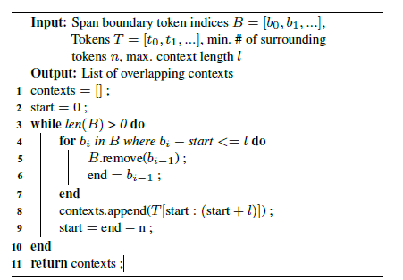
Dynamic Context Segmentation

Slide 10
Span NLI BERT

Slide 11
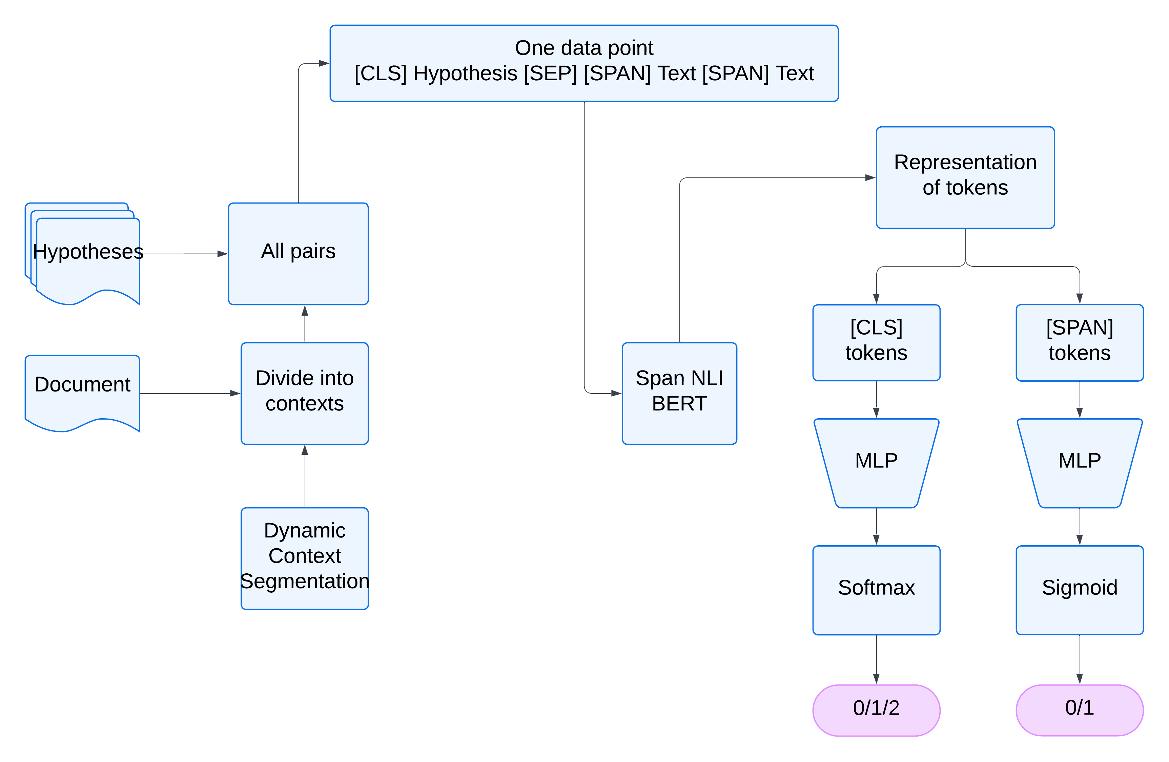

Slide 12
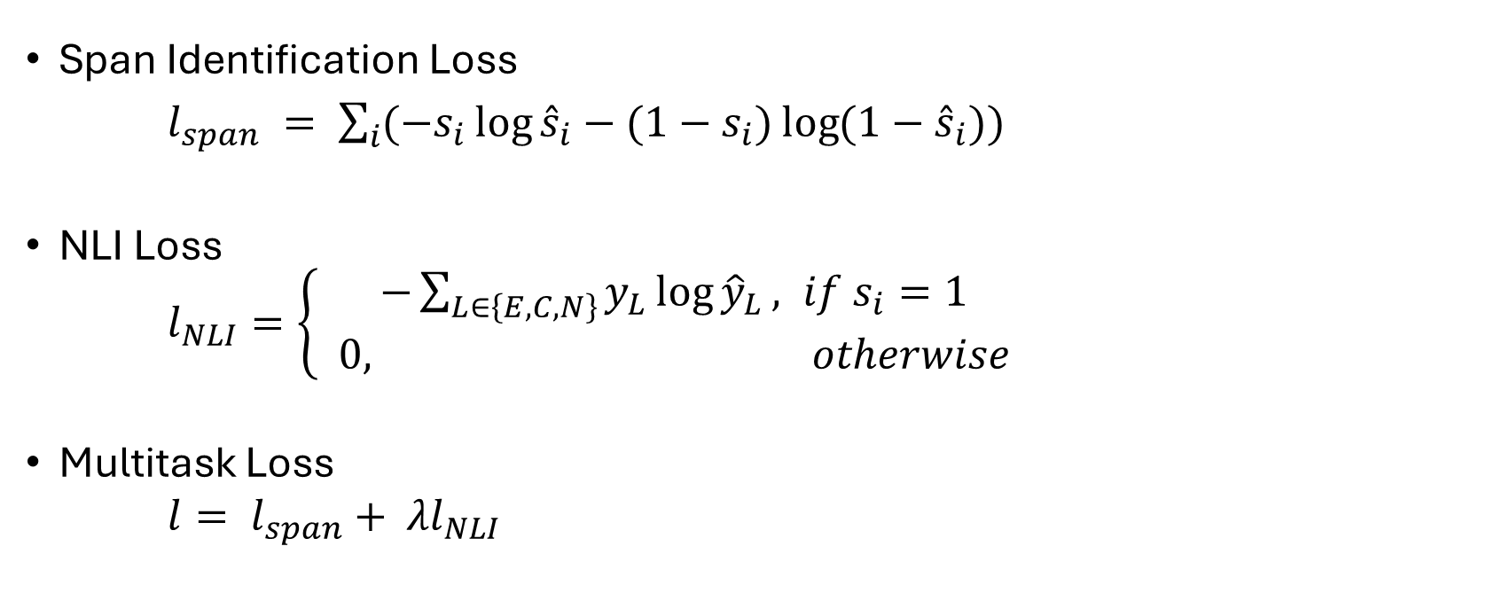
Loss Calculation
Span Identification Loss
$l_{span} = \sum_{i}{(−s_{i}\log{{\hat{s}}_{i}}−(1−s_{i})\log{(1−{\hat{s}}_{i})})}$
NLI Loss
$l_{NLI}=\left\{ \begin{aligned}−\sum_{L∈\left\{E,C,N\right\}}{y_{L}\log{{\hat{y}}_{L}}}, &if s_{i}=1 \\ 0, otherwise\end{aligned}\right.$
Multitask Loss
$l= l_{span}+ λl_{NLI}$

Slide 13
Results
 | Bert-base | Bert-base FFT | Bert-large | DistilBERT-FFT | DistilBERT-frozen | DistilBERT( lambda-0.05) | DistilBERT( lambda-0.2) | DistilBERT( lambda-0.4)
mAP | 0.5432 | 0.8378 | 0.5883 | 0.8501 | 0.5594 | 0.5704 | 0.5708 | 0.5699
P@R80 | 0.1015 | 0.6778 | 0.2567 | 0.7463 | 0.1113 | 0.1205 | 0.1208 | 0.1208
ACC(NLI) | 0.6054 | 0.6693 | 0.6554 | 0.6862 | 0.6059 | 0.6111 | 0.6152 | 0.6155
F1 (C) | 0.3024 | 0.2550 | 1.0 | 0.2768 | 0.2596 | 0.2659 | 0.2899 | 0.2900
F1 (E) | 0.2704 | 0.2646 | 0.2621 | 0.2948 | 0.2999 | 0.2932 | 0.2664 | 0.2656

Slide 14
Limitations and future work
Imbalanced label distribution and scarcity of data
Linguistic challenges
Negation by Exception
Discontinuous spans
Reference to Definition

Slide 15
Thank You

